Slide 1

Terminal application
Derrick Lai

Slide 2
Outline
Overview of terminal application
Features of terminal application
Logic of code
Challenges
Moving forward

Slide 3
Overview
My app is called “I’m hungry so where do we eat?” app
The idea comes from having trouble of choosing a place to eat ALL THE TIME
So why not make an app to do that for me
An app that utilizes Zomato API to display restaurants (only 100 available)

Slide 4
Features
Calling multiple Zomato API using HTTParty and nested loops
Sorting through all the API calls and extracting only necessary information

Slide 5
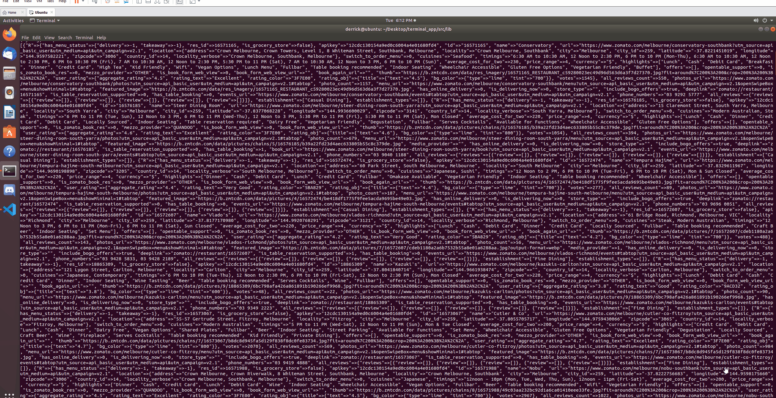

Slide 6
Features
Calling multiple Zomato API using HTTParty
Extracted necessary information from API request
Formatting extracted information into Terminal Table format (array of arrays)
Sorting according to price, cuisine type and ratings
Generate a random restaurant to DINE IN for the day

Slide 7
Logic
Implemented nested loop with the use of an array of API request url
Using JSON.parse to turn return of API from a string to hash and and working through the array to getting the correct returns
Sorting an array of GIANT hashes using sort_by
Generating a random sample of array using .sample

Slide 8
Challenges
Calling multiple API and sorting using the correct keys for the return hash
Sorting process
DRYness of code
Struggling for more user input interfaces
Still grasping concept of Class

Slide 9
Favourites
Dug real deep for the API return and returning something I need
Sorting an array of hashes by it’s variables
When I can say goodbye to bugs after finding out bugs using byebug
When it just works

Slide 10
Moving forward
REQUIRED
Error handling
Executable
More user input features
EXTRA
Making application more ‘appealing’
Implementing a feature for user to input ‘missing’ restaurants
Implementing a ‘Favourites’ interface
Implementing data storing in JSON file
Generating a random restaurant from ‘Favourites’ list

